Slide 1
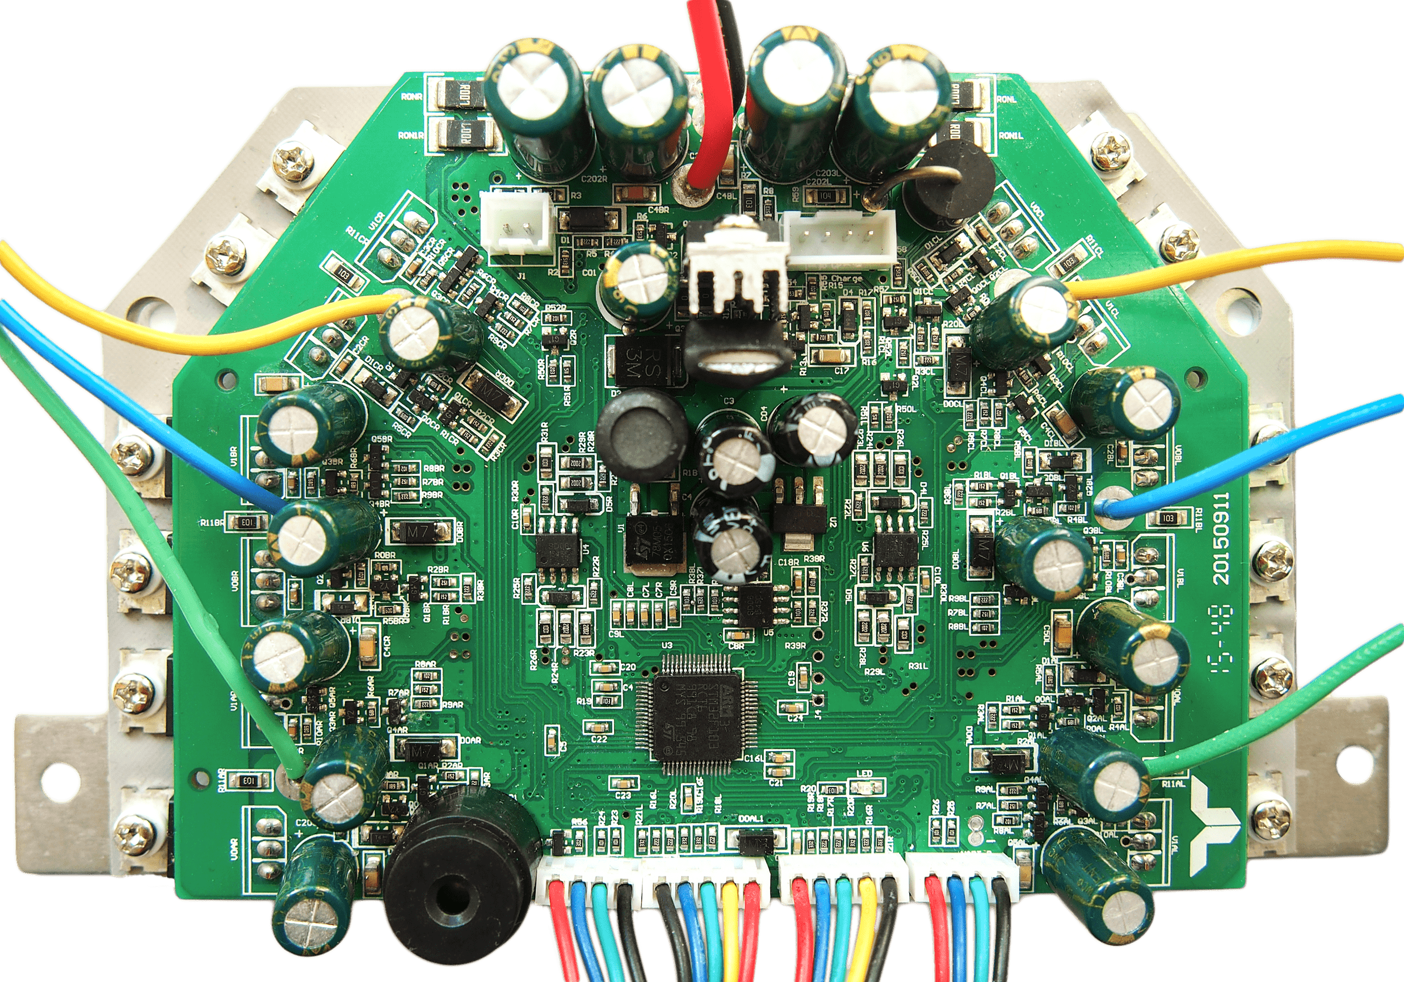
Power Button
XT60 Main Power
PA1 / Button Pin
Charger Connector
PA5 / Latch Pin
PA12 / Charger Pin
Motor Wires
Right Motor Current
PC5 / Phase C
Left Motor Current
PC4 / Phase B
PC3 / Phase B
SWD Programming
PA0 / Phase A
3.3V 30mA max.
DC Link Current
PA14 / SWCLK
PC0 / Left Motor
GND
PC1 / Right Motor
PA13 / SWDIO
Left Hall Cable
Right Hall Cable
GND
5V 100mA max.
HALL A
HALL A
HALL B
HALL B
HALL C
HALL C
5V 100mA max.
GND
Left Sideboard
Right Sideboard*
15V 200mA max.
15V 200mA max.
PA2 / TX / ADC1
PWM1
PWM1
PB10 / TX / SCL
PA3 / RX / ADC2
PWM2 / PPM / iBUS
iBUS / PPM / PWM2
PB11 / RX / SDA
GND
*5V Tolerant
GND

Slide 2
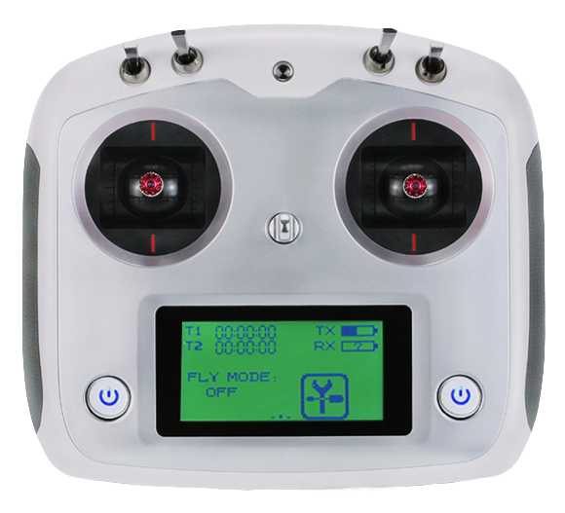
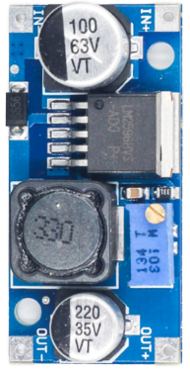
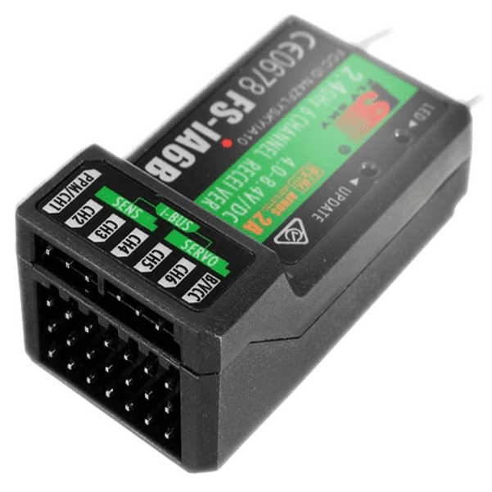

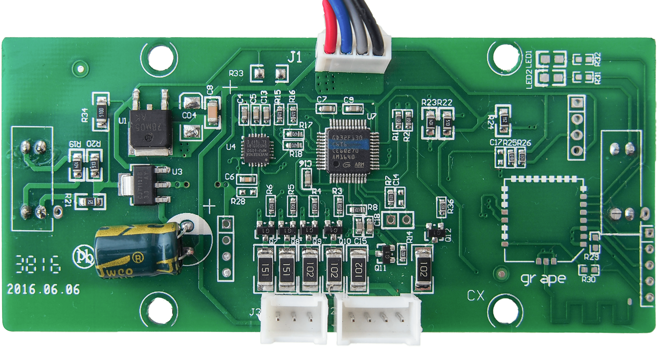
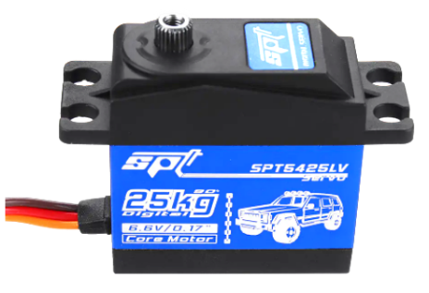

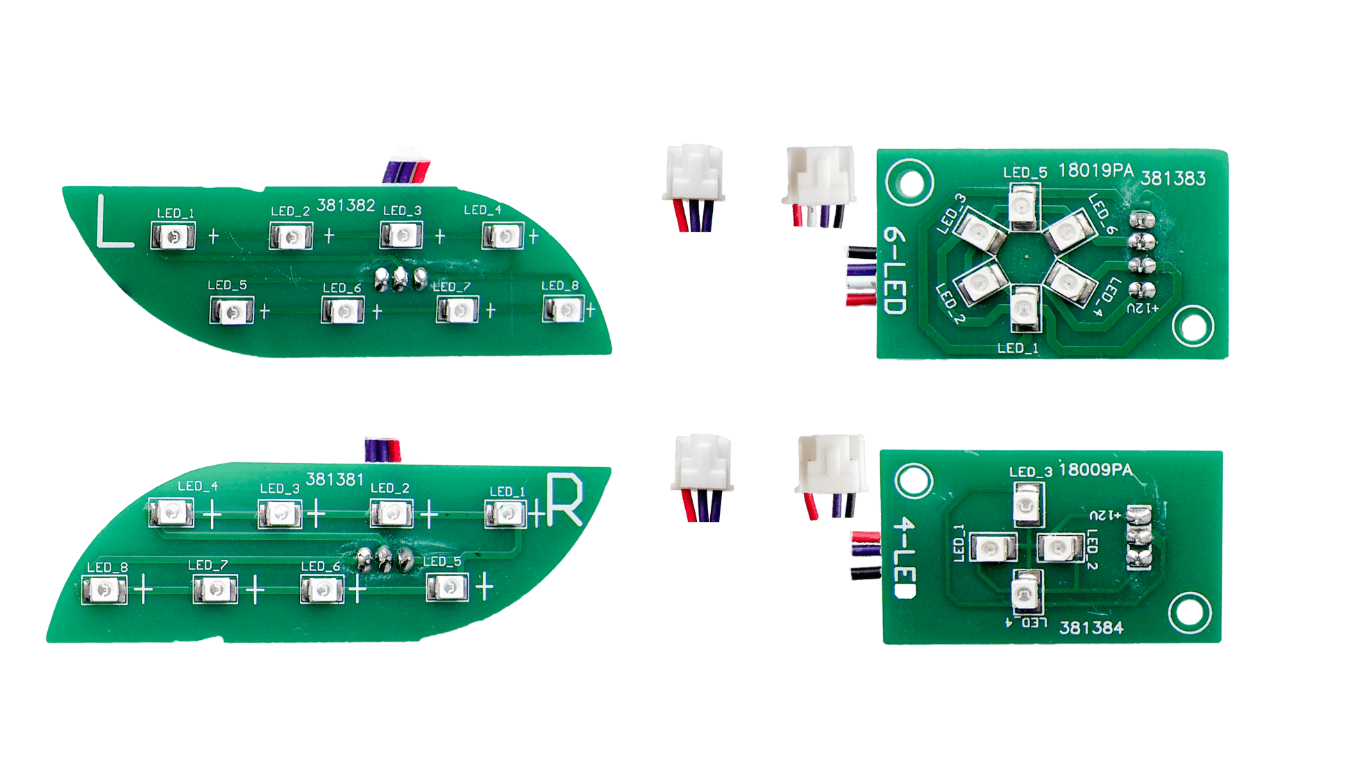
VARIANT_HOVERCAR
Power Button
RC circuit (optional)
TIP127 pin2
Voltage
Speed
Torque
VDD 36V - 42V
Not used
Not used
Not used
Control Mode
Pedals
RC
Control
Flysky i6S
Field W.
Off
On
Pull-down
resistors
Switch
In: 36V - 42V
CH4 / Servo
CH1 / Steer
Left Cable
DC-DC Converter
LM2596HV
CH2 / Speed
PA2 / TX / ADC1
100k
CH2 Failsafe: 0%
PA3 / RX / ADC2
100k
GND
Out: 6.6V
3.3V 30mA max.
Right Cable
Brake
Throttle
FS-iA6B iBUS
CH4
GND
Steering Servo
min. 25kg
PA10 / AUX_RX
parallel connection
100 Ohm
Front LEDs
Battery Level

